Slide 1
^{Art + Game}
Gamedevs- games of the future

Slide 2
AGENDA
VISION
PROJECT MANAGEMENT
TECHNOLOGIES
LIVE DEMO
ARCHITECTURE
QUALITY ASSURANCE
YOUR QUESTIONS
Notes:
VISION - Danny
TECHNOLOGIES - Domi
PROJECT MANAGEMENT - Danny
LIVE DEMO - Adi
ARCHITECTURE - Domi
AUTOMATION - Adi
TESTING - Domi
YOUR QUESTIONS

Slide 3
^{VISION}
Gamedevs- games of the future

Slide 4
MOTIVATION
Why you need A+G
DESIRE TO CREATE GAME
INSPIRED BY ZELDA
BECOME A GREAT GAME DEV
CREATE INTERACTIVE ART
HAVE FUN
GOAL:
Make a really fun game, combining both Art and Game.

Slide 5
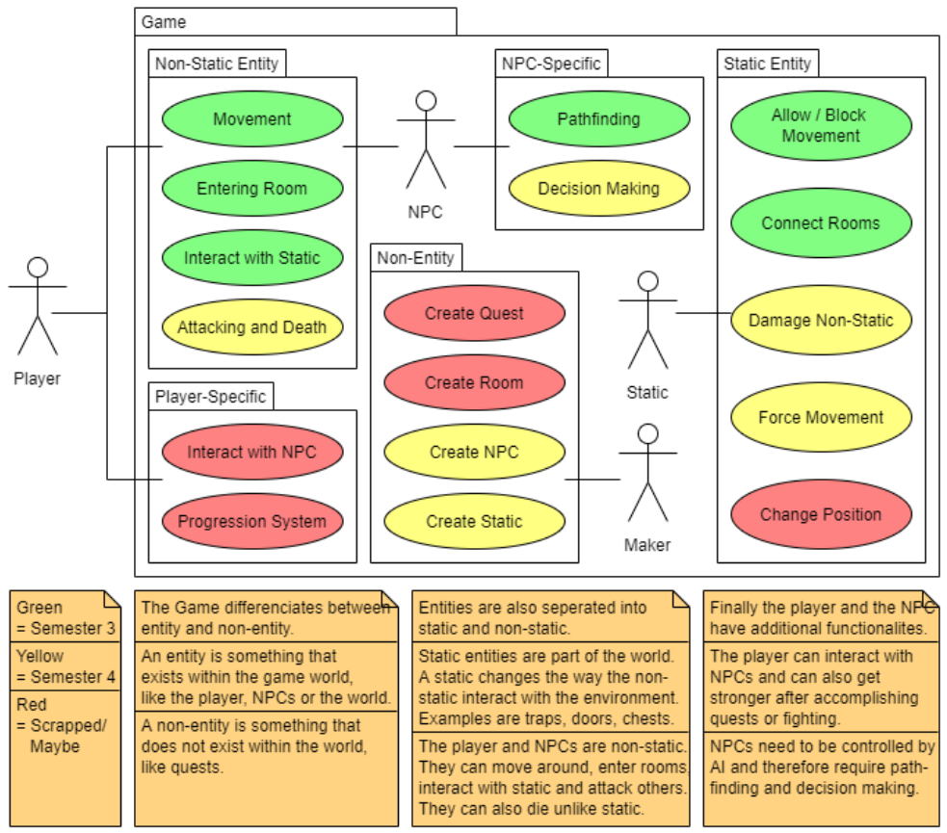
COMPONENTS
How A+G works

Slide 6
^{Project Management}
Gamedevs- games of the future

Slide 7
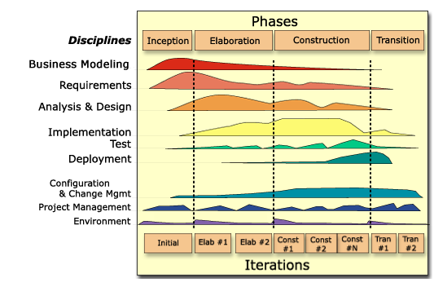
PLANING
@RUP

Slide 8
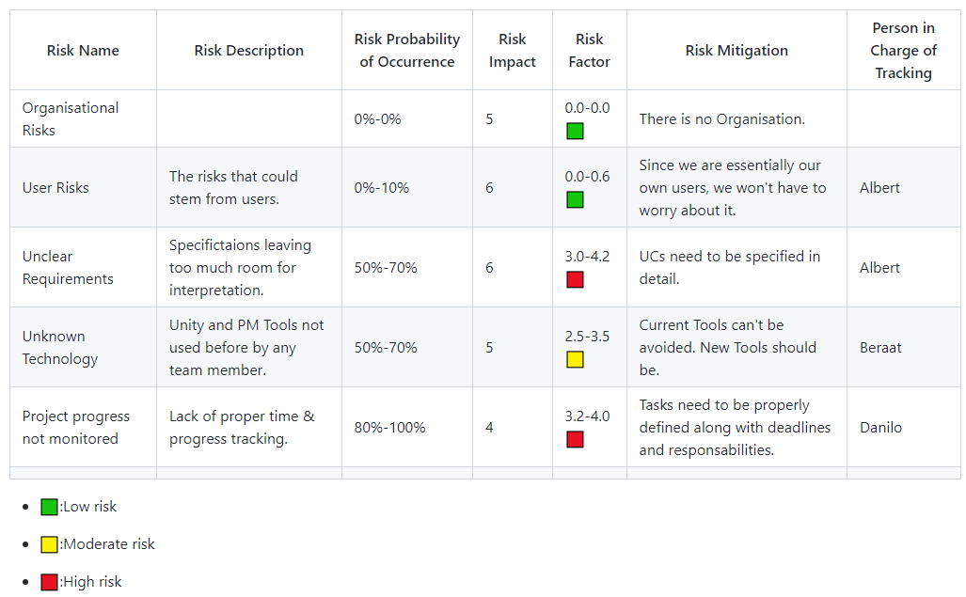
Risk Management
@Risk

Slide 9
SCRUM
Why we do not waterfall

Slide 10
Platform
Where we stand on YouTrack

Slide 11
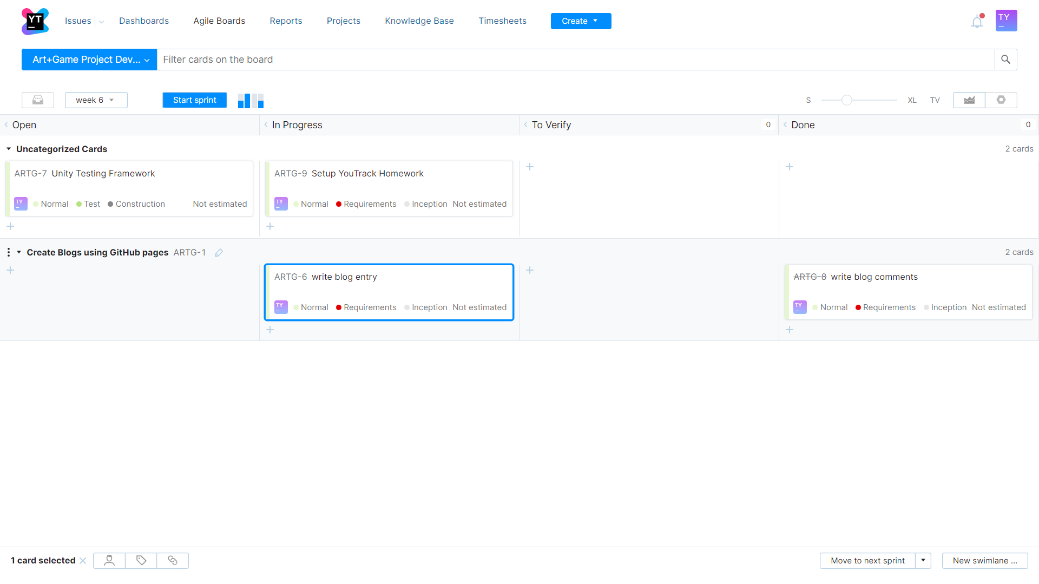
SPRINTS
How we keep track

Slide 12
^{TECHNOLOGIES}
Gamedevs- games of the future

Slide 13
TECHNOLOGIES – C#
general-purpose, multi-paradigm programming language
Future proof programming language
Developed by Microsoft
Best Practices
Full Documantation
Faste and easy Software Development

Slide 14
TECHNOLOGIES – Unity
a cross-platform game engine
Future of Software Development
Open Source Project
Best Practices
Full Control
Faster Software Development → Lower Costs

Slide 15
^{Live Demo}
Gamedevs- games of the future

Slide 16
^{ARCHITECTURE}
Gamedevs- games of the future

Slide 17
ARCHITECTURE – Unity Native Model
Scripts
Unity already handles most if not all of the visuals within its editor, using the Animator with .anim files for animations for example
Game object can possess any amount of custom properties similar to models
Any logic for any game object is contained within the corresponding script which controls the game object

Slide 18
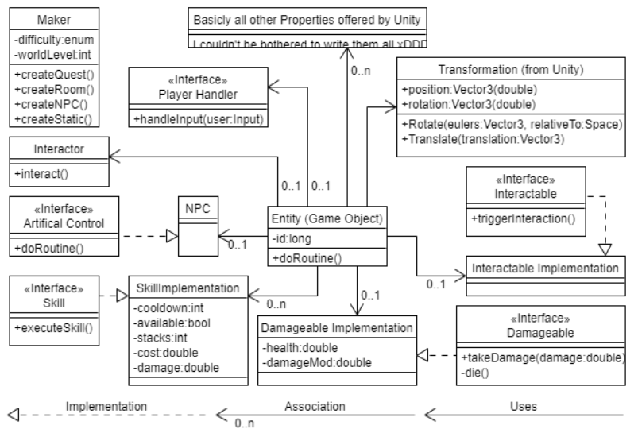
ARCHITECTURE - CLASS DIAGRAM
Overall Software Structure

Slide 19
^{Quality Assurance}
Gamedevs- games of the future

Slide 20
Unity Testing Framework
Quality Assurance

Slide 21
Metrics
Quality Assurance

Slide 22
THANK YOU
FOR YOUR ATTENTION
WE WILL BE HAPPY TO ANSWER YOUR QUESTIONS

